Slide 1
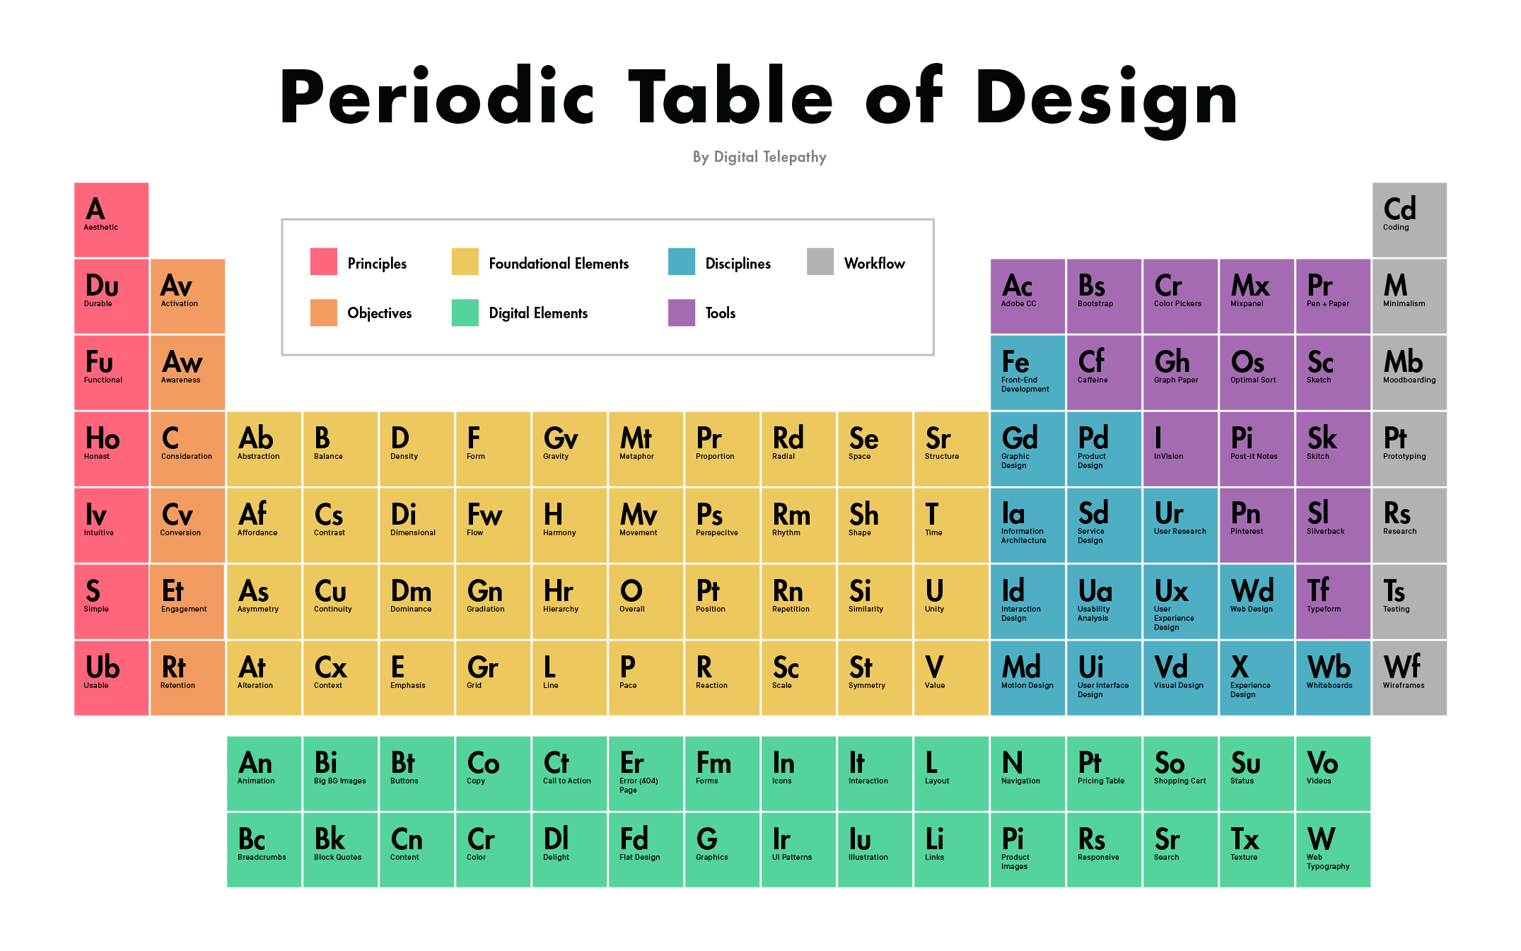
Mini Project
Digital Modern Periodic Table
Guided By –
A. B. Patil Sir
Project By –
Rushikesh Mhetre (A26)
Sanghavi Dorlikar (A28)
Prathamesh Chavan (A36)
Akshata Kulkarni (A37)

Slide 2
CONTENTS
Objective
Working principle
Header files and functions
Key features

Slide 3
OBJECTIVE
The Digital Modern Periodic Table project is a simple Educational console application built without the use of graphics.
It is developed using the C++ programming language for the purpose of storing name, symbol, atomic number, atomic weight, and some important properties as well as to display them as per requirement of the user.
The source code for this project is complete and totally error free, and we welcome any feedback and suggestions.

Slide 4
WORKING DESCRIPTION
This program is based on the 'Modern Periodic Table of Elements. It showcases all the elements and their basic properties including name, symbol, atomic number. atomic mass group and period.
This program contains 4 options:
Search for an element
View Modern periodic table
Block wise properties info
Exit from application.

Slide 5
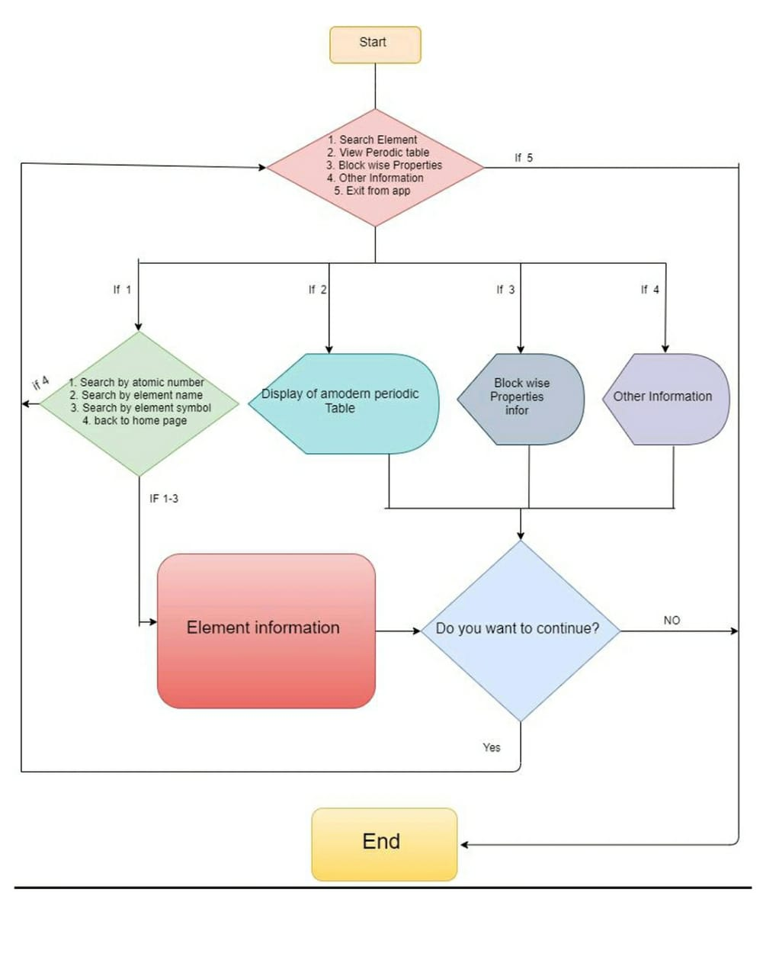
DESIGN

Slide 6
HEADER FILES & FUNCTIONS
Header Files:
1. iostream
2. conio.h
3. string.h
4. stdio.h
5. windows.h
6. process.h
Inbuilt Functions:
goto()
strcmpi()
strcpy()
clrscr()
getch()
gets()
Main()

Slide 7
KEY FEATURES
Exploration of element Information: The main function of this project is to explore or to display the stored information. You can search an element by using any of the following method:
By name of element
By symbol of element
By atomic number of element
Block wise properties information: User will find it easier to get basic information of all the four blocks of Modern Periodic Table.
Origin of every element

Slide 8
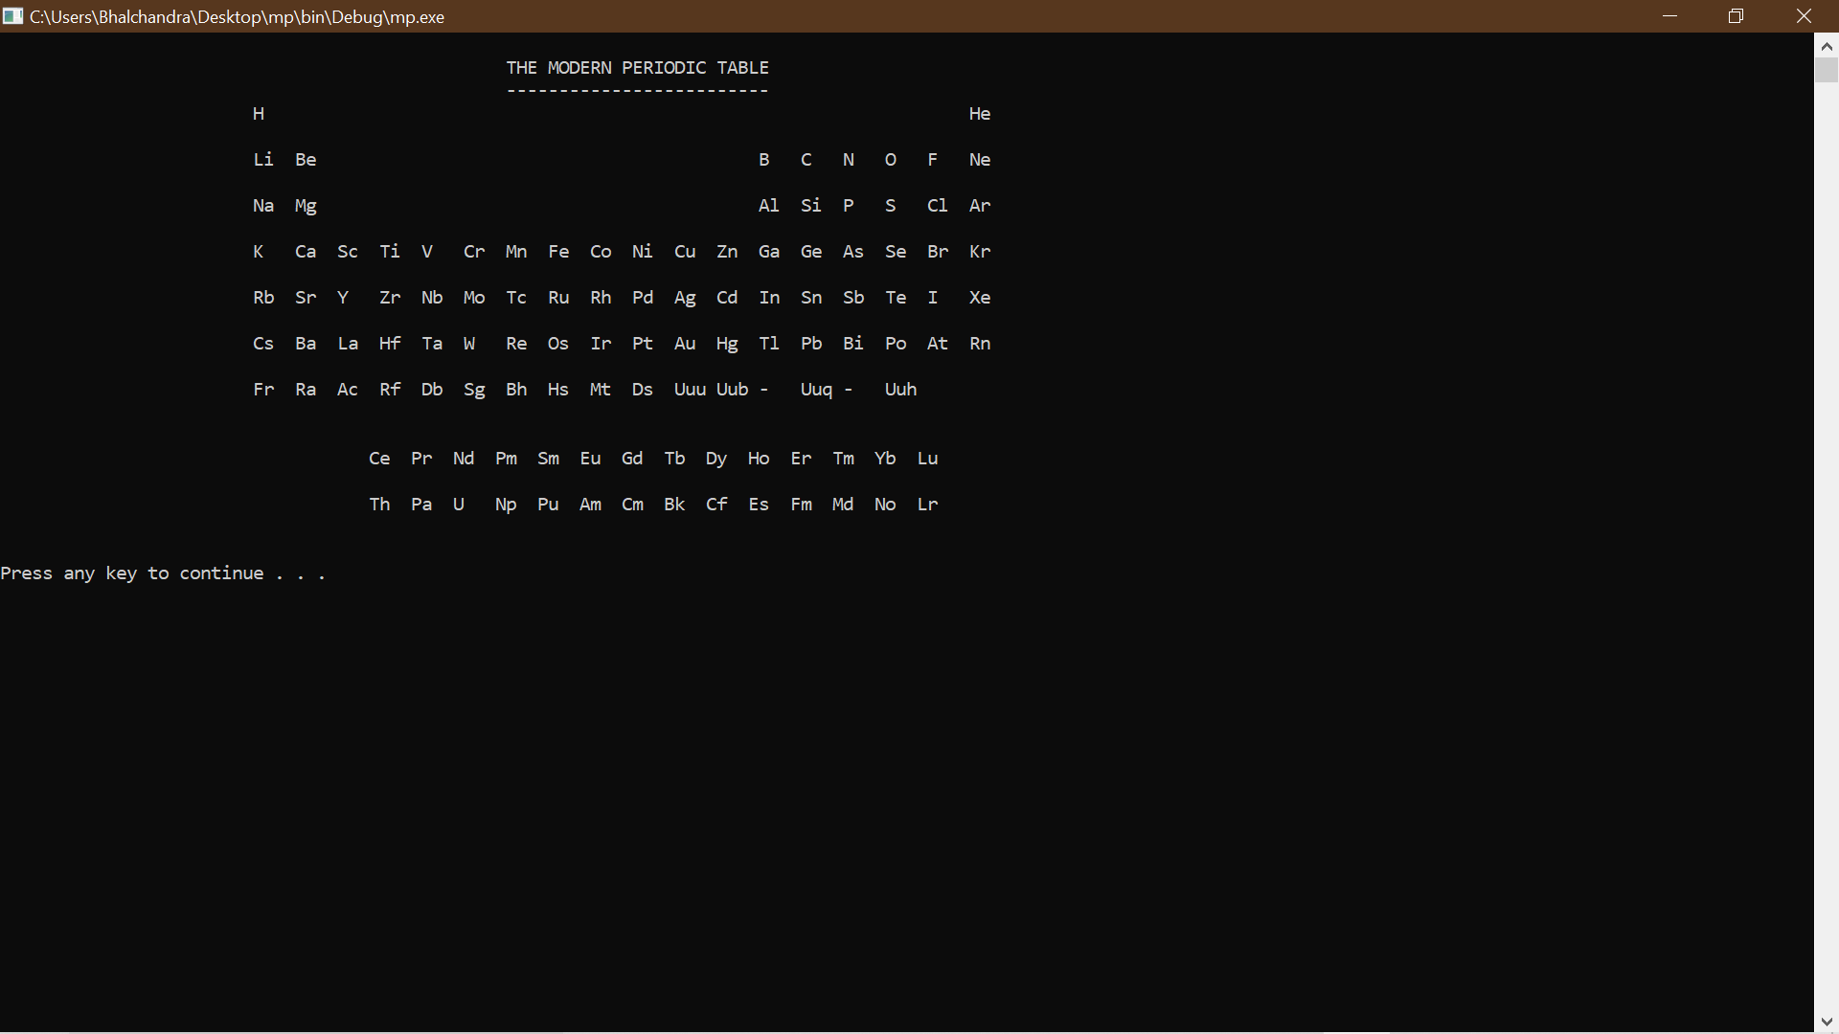
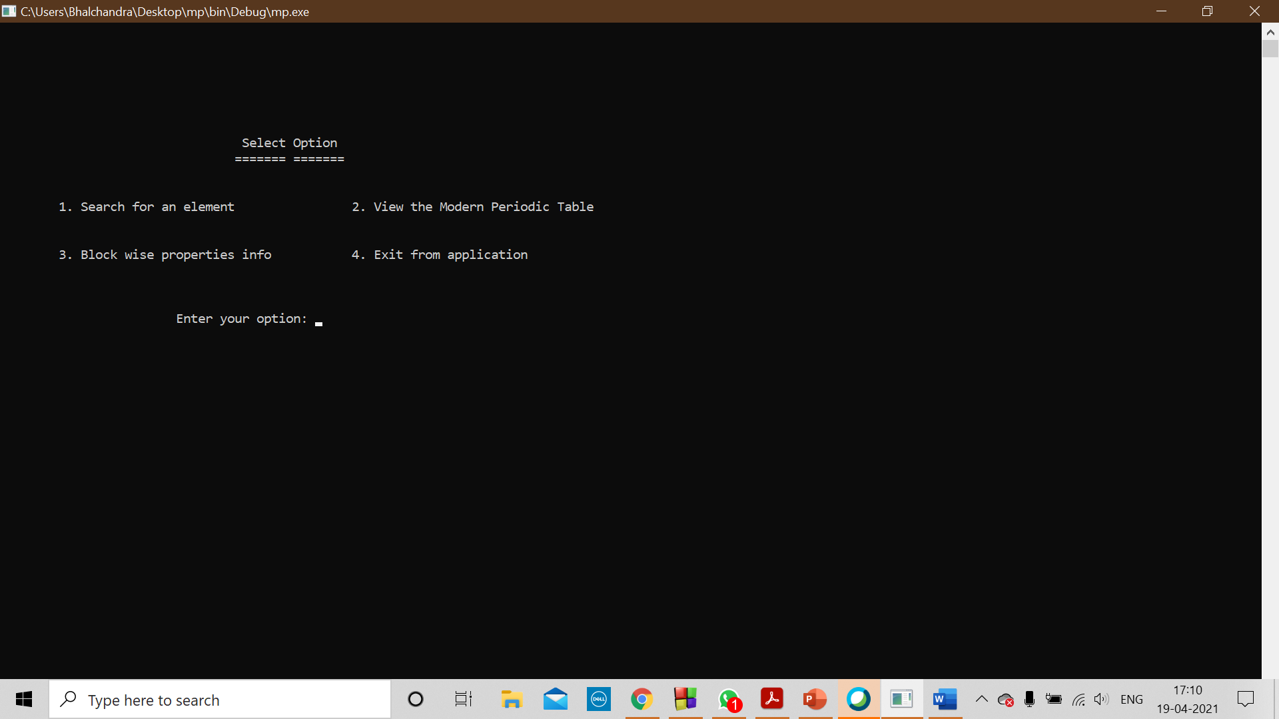
Modern Periodic Table display window
Option window

Slide 9
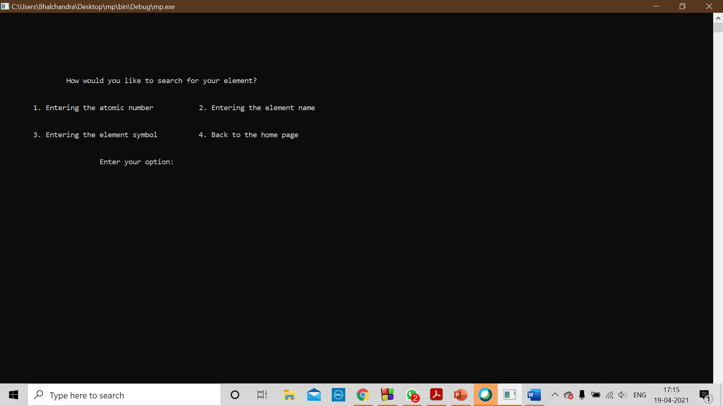
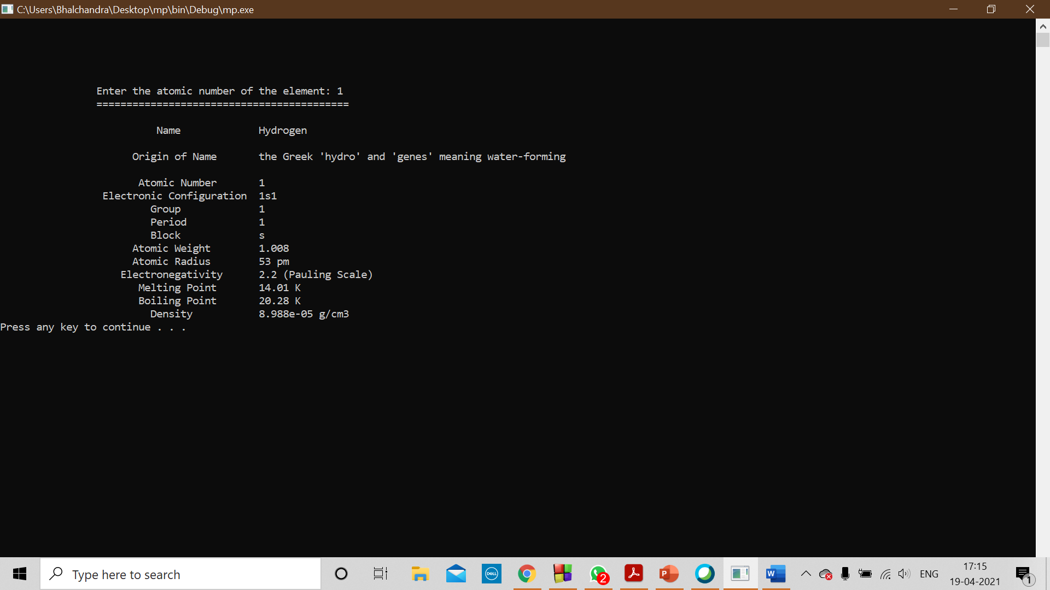
Option 1 window
Element information window

Slide 10
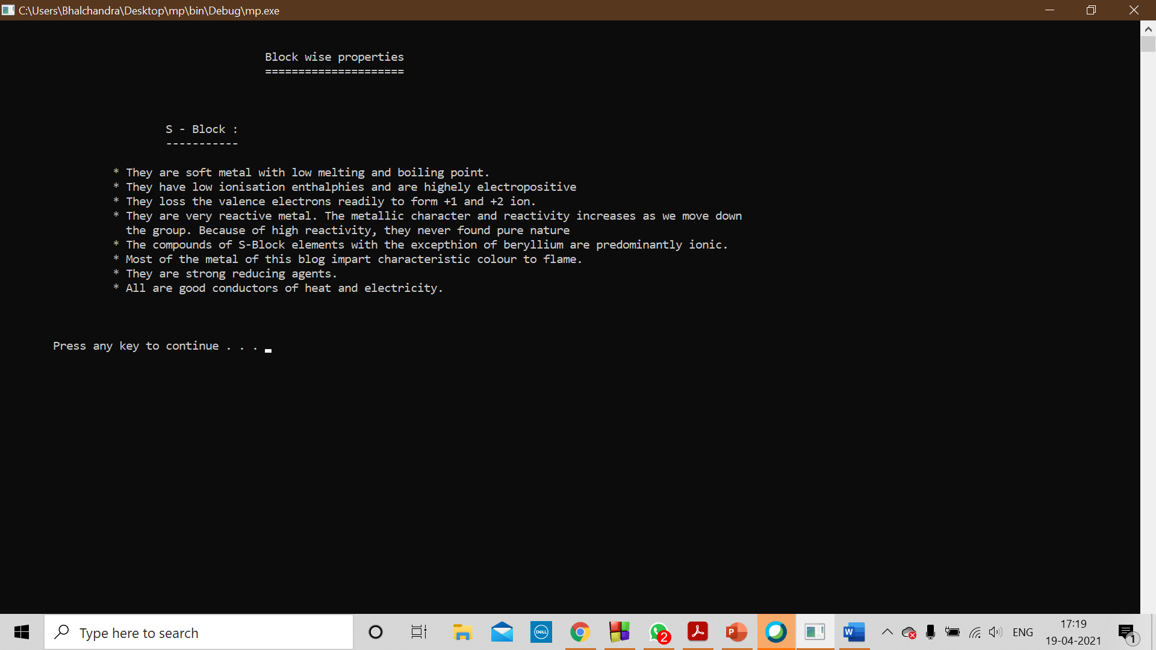
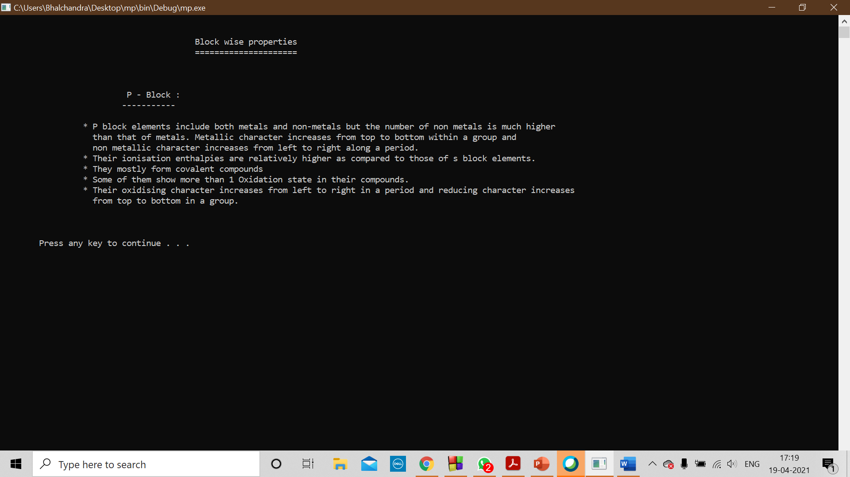
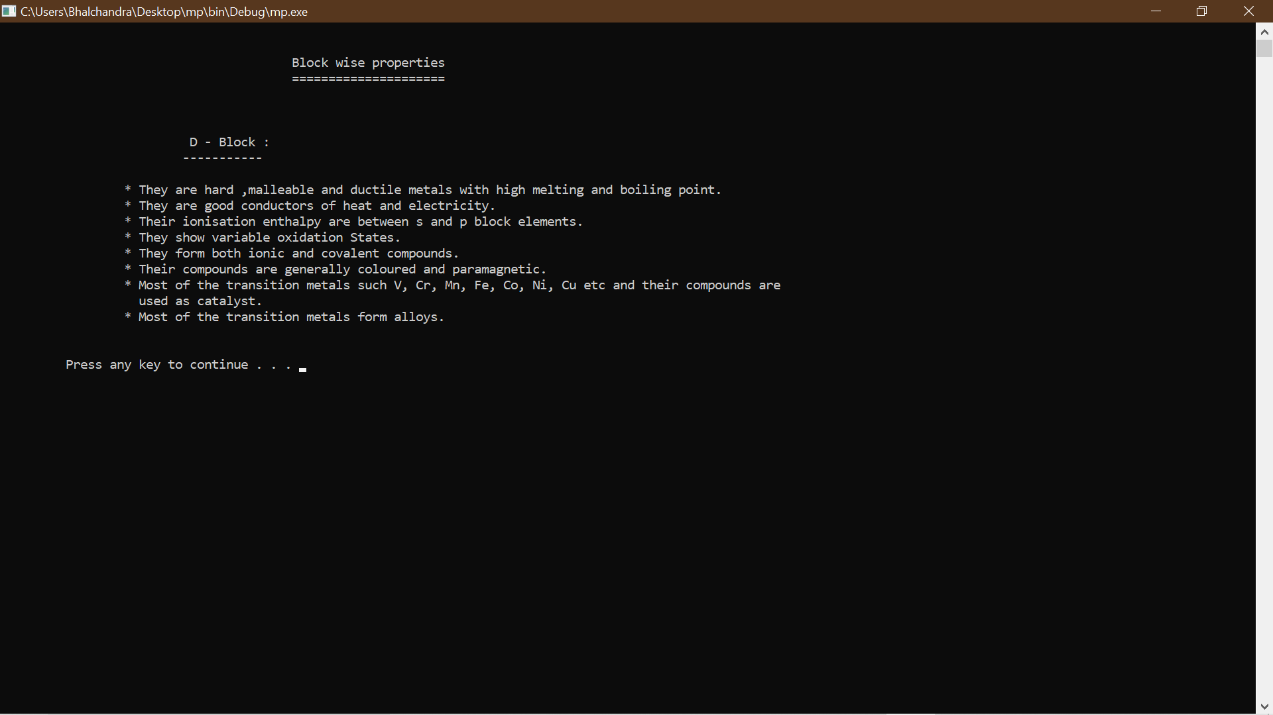
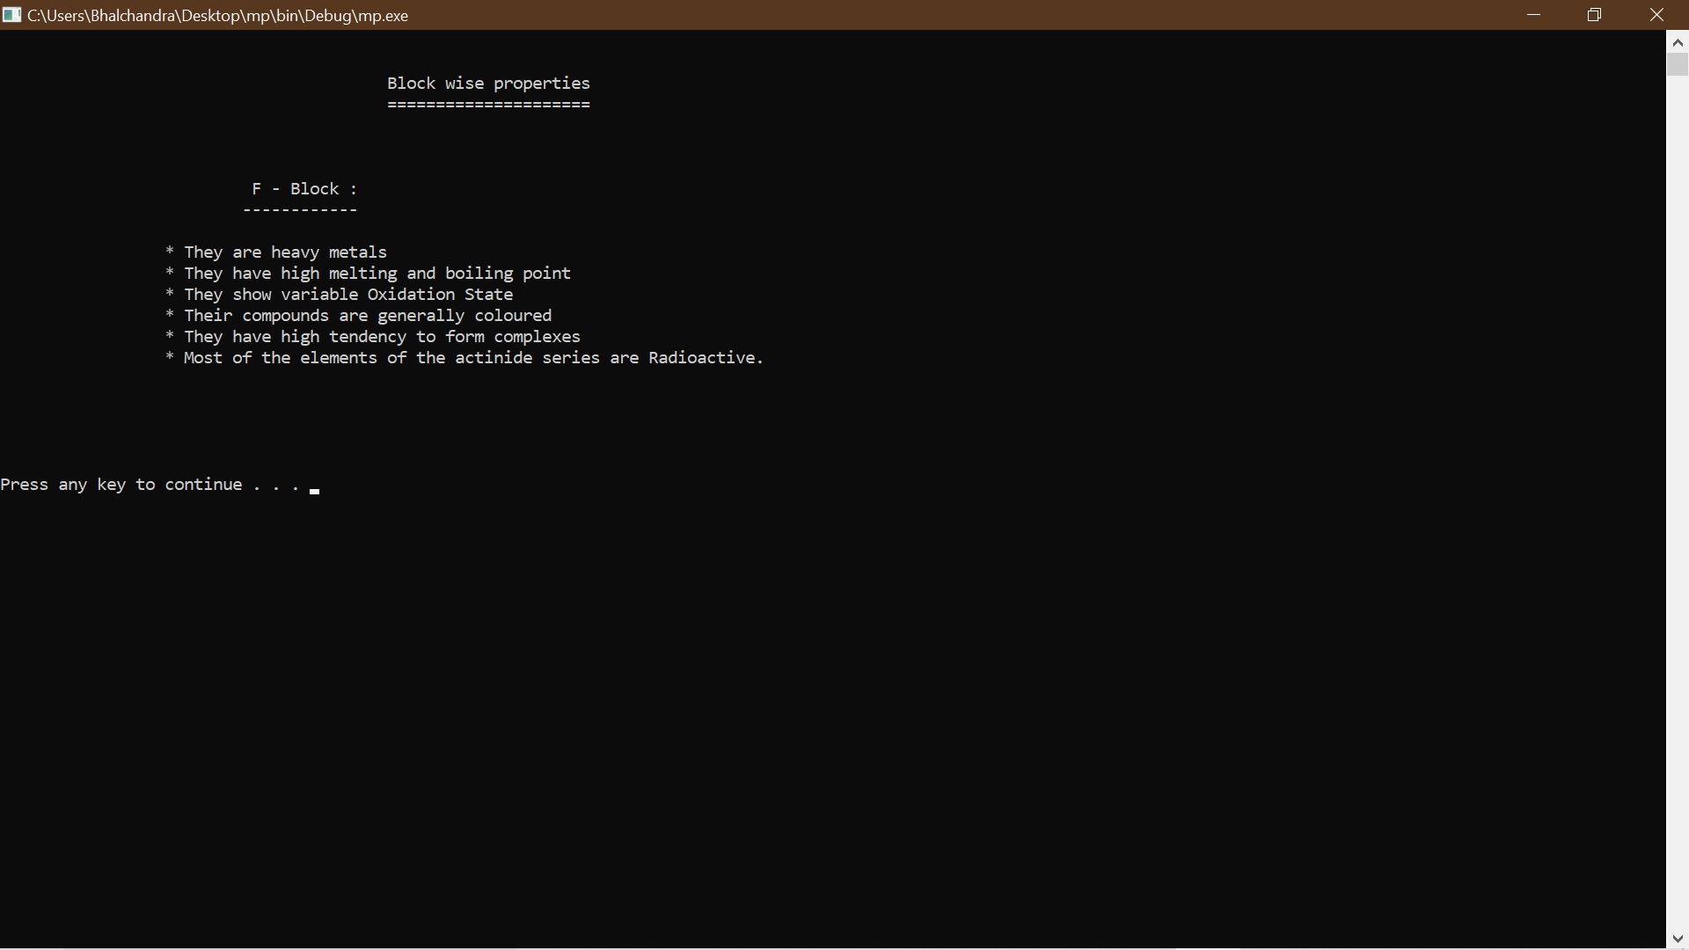
Block information windows

Slide 11
CONCLUSION
Modern Periodic Table is very useful application for the students where they can access to all the information of a particular element in just one click.
Keep Learning…

Slide 12
Thank you

